Slide 1
Why & How Containers
Steve Lasker
Program Manager
Azure Developer Experiences
@stevelasker
blogs.msdn.microsoft.com/SteveLasker
aka.ms/acr
aka.ms/acr/build
aka.ms/acr/geo-replication
aka.ms/acr/docs
github.com/SteveLasker/Presentations

Slide 2



Containers as a common deployment currency
AKS
ACI
Service Fabric
App Service
IoT
Machine Learning
…
Private Registry
Custom Apps
ISV, Packaged Apps
Azure Container Registry
Azure clients: PS, CLI, Portal, SDK)
Developer tools: VS, VS Code, VSTS
OSS clients: GitHub, Terraform, Draft, Helm, etc.,

Slide 3
Containers Orchestration Running reliable services

Slide 4
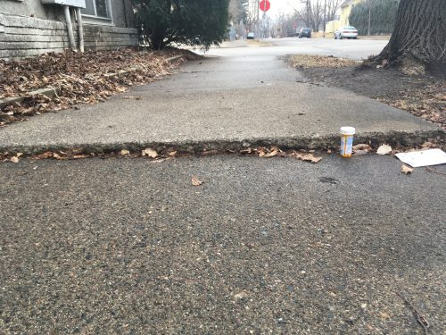


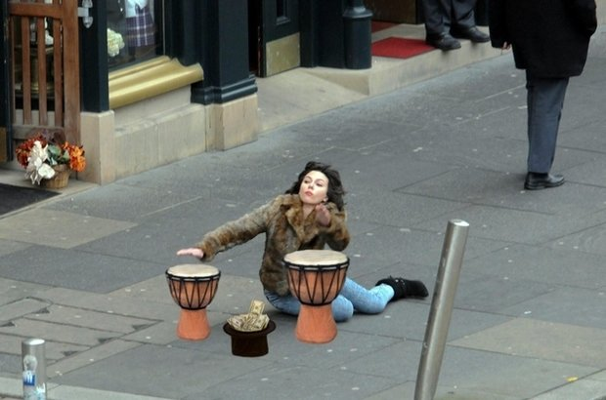
Container Orchestration & Reliability
Designing with the knowledge something will fail at any point

Slide 5
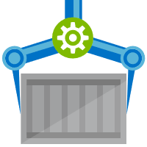


Release Management
Resource Pool
Orchestration
HOST-A
Deploy:
web:1 x3
quotes:1 x3
important:1 x4
Image Cache
3
web:1
digest: 91e
web:1
digest: 91e
Foo:
web:1 x3
quotes:1 x3
important:1 x4
web:1
digest: 91e
quotes:1
digest: u82
Container Builder
Container Registry
important:1
digest: 2re
important:1
digest: 2re
HOST-B
Image Cache
quotes:1
digest: u82
quotes:1
digest: u82
7
6
quotes:1
digest: u82
5
web:1
digest: 91e
important:1
digest: 2re
important:1
digest: 2re
important:1
digest: 2re
quotes:1
digest: u82
1
quotes:1
digest: u82
docker build –t web:1
docker build –t quotes:1
docker build –t important:1
docker push web:1
docker push quotes:1
docker push important:1
important:1
digest: 2re
important:1
digest: 2re
Image
web:1
quotes:1
important:1
2
web:1
digest: 91e
HOST-C
quotes:1
digest: u82
4
important:1
digest: 2re
8
Image Cache
quotes:1
digest: u82
quotes:1
digest: u82
important:1
digest: 2re
important:1
digest: 2re
Notes:
Orchestrator icon from: http://cdn.marketplaceimages.windowsphone.com/v8/images/f58edb21-b20c-4315-b837-6cee21n442cd?imageType=ws_icon_large
https://git-scm.com/book/en/v2/Git-Branching-Basic-Branching-and-Merging

Slide 6
Authenticating with ACR
User and Service Authentication

Slide 7
Authenticating with ACR
Using familiar docker CLIs
Individual Identity, using Azure Active Directory Identity
Server/Headless identity using AAD Service Principals
Provision Service Principals, with scoped access control
Contributor – Push/Pull
Reader – Pull Only
Eg: assign the Kubernetes created principal, desired access to each registry
az login
az acr login --name [registryName]
docker push / pull

Slide 8
Defaults
Avoid having to set the same registry name, over, over, over, over, again
az configure --defaults acr=[registryName]
az configure --defaults acr=demo42

Slide 9
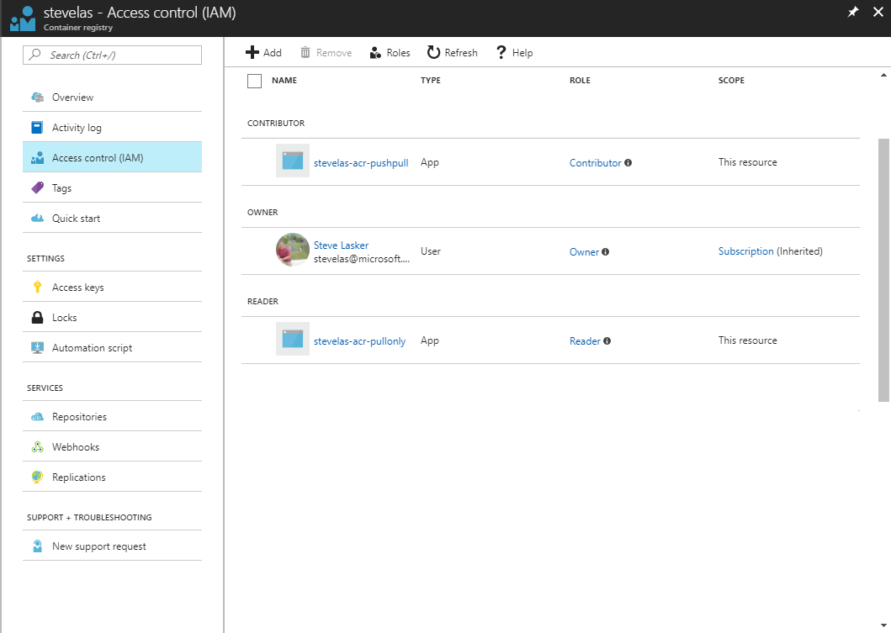
Owner – Push, Pull, ARM Resource Management eg: IAM configuration
Contributor – Push, Pull
Reader – Pull Only

Slide 10
ACR Roles and Permissions
Role/Permission | ARM Access | Create/Delete ACR | Push | Pull | Policy Changes | Change Quarantine State | Pull Quarantine Images | Signature Signing
Owner
Contributor
Reader
AcrPush*
AcrPull*
AcrImageSigner
AcrQuarantineWriter*
AcrQuarantineReader*
* - coming soon, not available as of 7/20/2018

Slide 11
Container Lifecycle Primitives

Slide 12




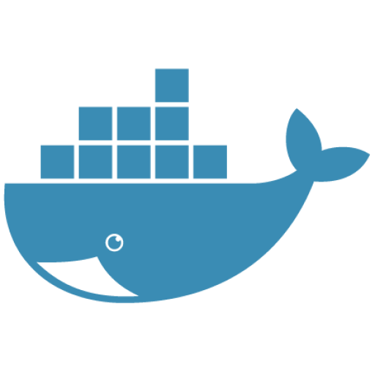




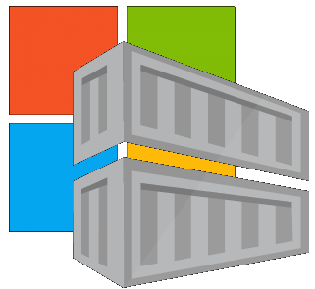


Container Lifecycle Primitives
Host agents monitor, protect and report running containers
3
Container Service
Container Instances
Source Code Control
(SCC)
Build/CI,
Integrate,
Test
CD, Deploy
7
App Services
Upon release, set released flag in ACR (ACR-Auto-purge policies)
Service Fabric
.NET
6
Base Image Index
4
8
1
2
Azure Functions
Docker Hub
ACR Build
Azure Container Registry
IoT
Azure Container Registry
Image Security Scanning
Secure by default
Microsoft Container Registry
Inner-Loop
Azure Batch
Run
5
Code
Validate
Debug
* Work in progress

Slide 13
Image Tagging
Why stable tagging can create instability

Slide 14
HOST-A
Deploy:
web:1 x3
quotes:1 x3
important:1 x4
Image Cache
3
web:1
digest: 91e
web:1
digest: 91e
Foo:
web:1 x3
quotes:1 x3
important:1 x4
web:1
digest: 91e
quotes:1
digest: u82
quotes & important are in inconsistent states
1
important:1
digest: 2re
important:1
digest: 2re
docker build –t web:1
docker build –t quotes:1
docker build –t important:1
docker images
REPOSITORY TAG DIGEST
web 1 91e
quotes 1 u82
important 1 2re
docker push web:1
docker push quotes:1
docker push important:1
HOST-B
Image Cache
quotes:1
digest: u82
quotes:1
digest: u82
9
8
web:1
digest: 91e
5
important:1
digest: 2re
quotes:1
digest: 3rp
important:1
digest: 1n4
important:1
digest: 2re
quotes:1
digest: u82
quotes:1
digest: u82
important:1
digest: 2re
important:1
digest: 2re
Digests
91e
u82
2re
Image
web:1
quotes:1
important:1
2
Digests
91e
u82
2re
3rp
1n4
web:1
digest: 91e
HOST-C
quotes:1
digest: u82
7
4
important:1
digest: 2re
Image Cache
quotes:1
digest: 3rp
quotes:1
digest: 3rp
6
docker build –t quotes:1
docker build –t important:1
docker images
REPOSITORY TAG DIGEST
quotes 1 3rp
important 1 1n4
docker push quotes:1
docker push important:1
important:1
digest: 1n4
important:1
digest: 1n4
quotes:1
digest: 3rp
important:1
digest: 1n4
Notes:
Orchestrator icon from: http://cdn.marketplaceimages.windowsphone.com/v8/images/f58edb21-b20c-4315-b837-6cee21n442cd?imageType=ws_icon_large
https://git-scm.com/book/en/v2/Git-Branching-Basic-Branching-and-Merging

Slide 15
Tagging Techniques
Base Images
FROM …
Stable Tags
Tag
:latest
:1
:2
:3
:1.0
:1.1
:1.2
:2.0
:2.1
:3.0
Digest
91efj6
u82lq
2re7f
3rpn1
1n4ef
5wd1k
Servicing Stable Tags
Tag
:latest
:1
:2
:1.0
:1.1
:1.2
:2.0
Digest
91efj6
u82lq
e8s1f
1n4ef
2re7f
3rpn1
28efq
Deployed Images
docker run …
Unique Tagging
Tag
:12204
:12328
:12401
:33810
:35091
:4201
:50201
Digest
91efj6
u82lq
e8s1f
1n4ef
2re7f
3rpn1
28efq
Notes:
[‎2/‎23/‎2018 3:18 PM] Sajay Antony:
https://git-scm.com/book/en/v2/Git-Branching-Basic-Branching-and-Merging
[‎2/‎23/‎2018 3:37 PM] Sajay Antony:
https://docs.docker.com/storage/storagedriver/
[‎2/‎23/‎2018 4:00 PM] Sajay Antony:
https://www.cockos.com/licecap/
[‎2/‎23/‎2018 5:10 PM] Sajay Antony:
https://docs.docker.com/datacenter/dtr/2.4/guides/user/create-promotion-policies/

Slide 16

ACR Build
A feature of Azure Container Registry
aka.ms/acr/build

Slide 17
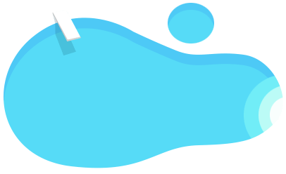




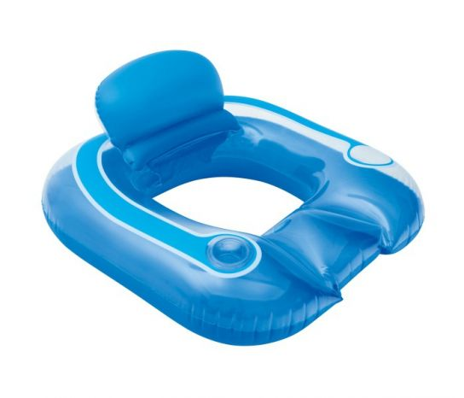
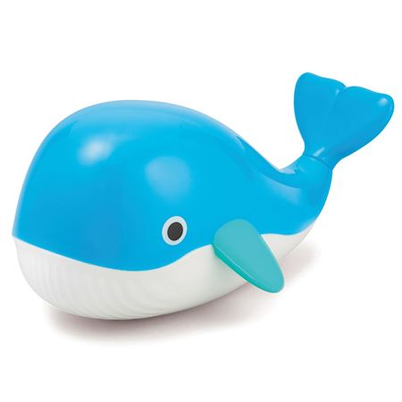

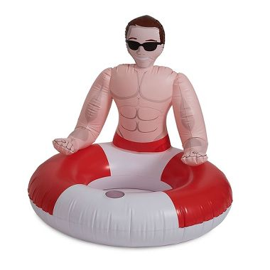
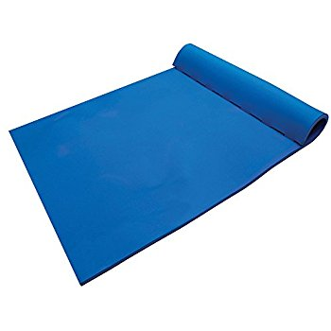
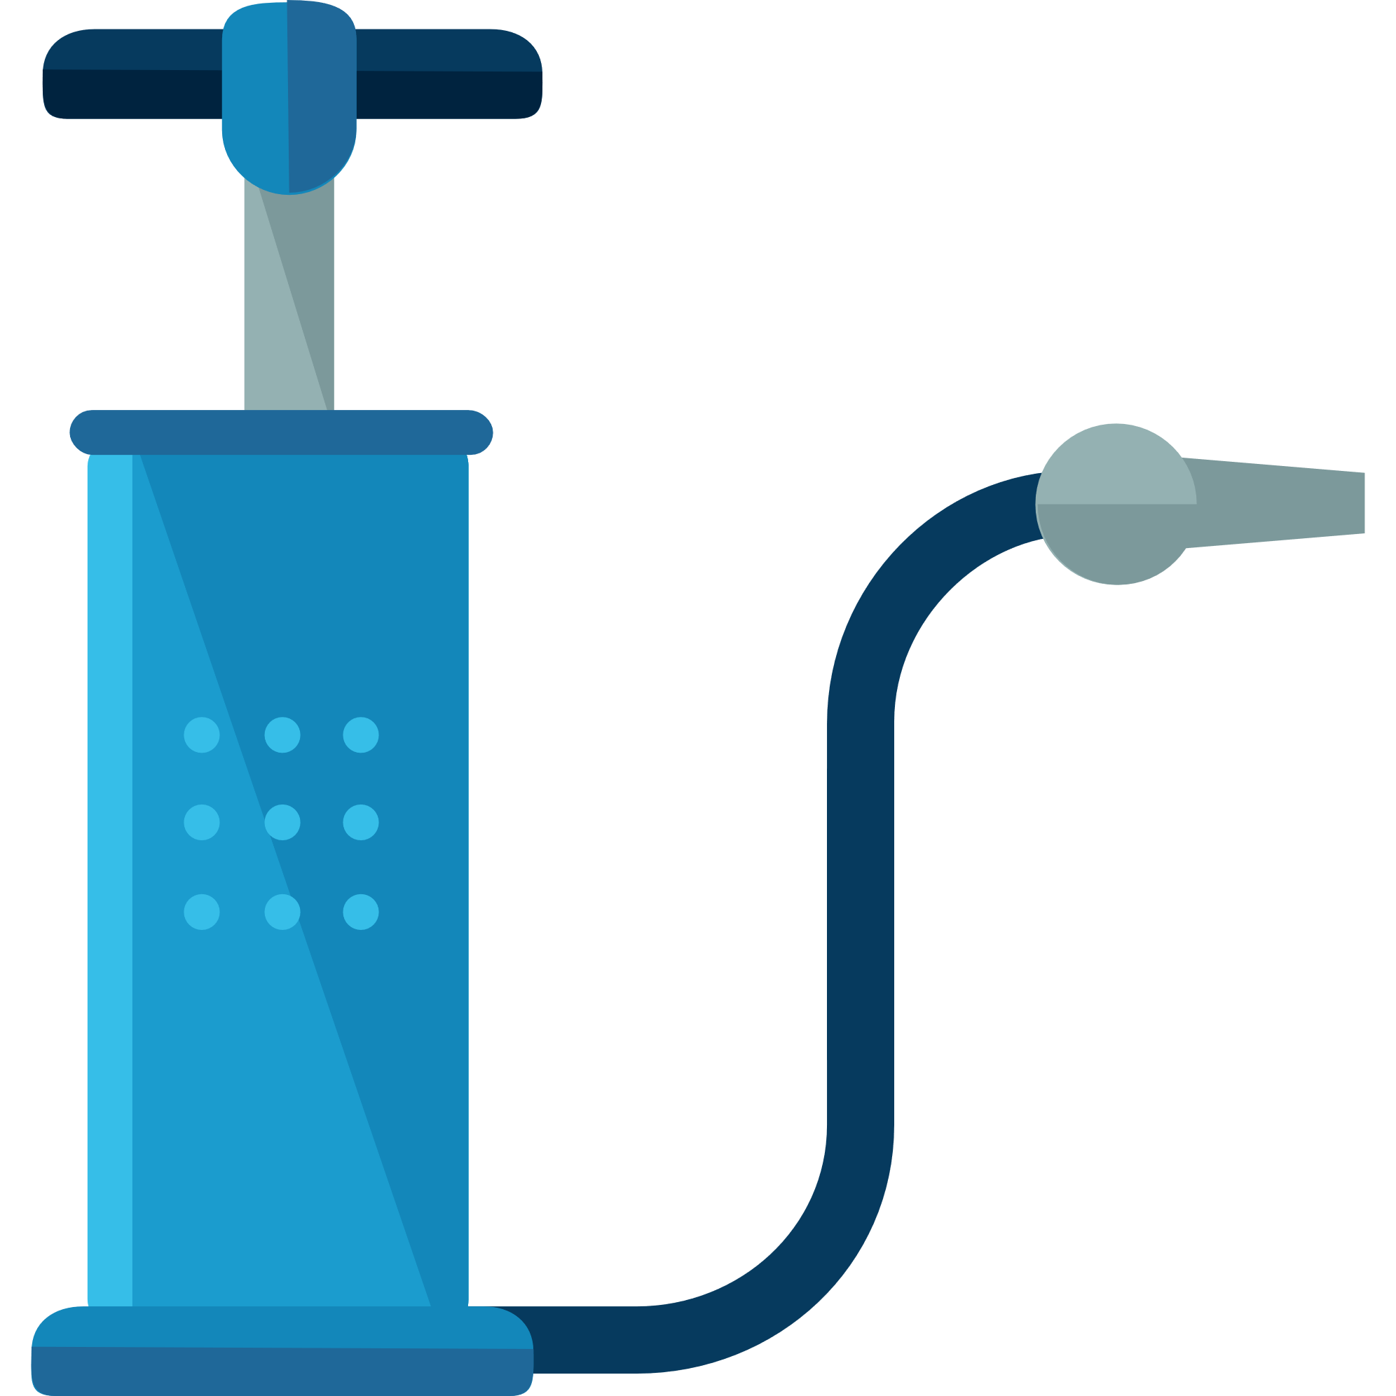


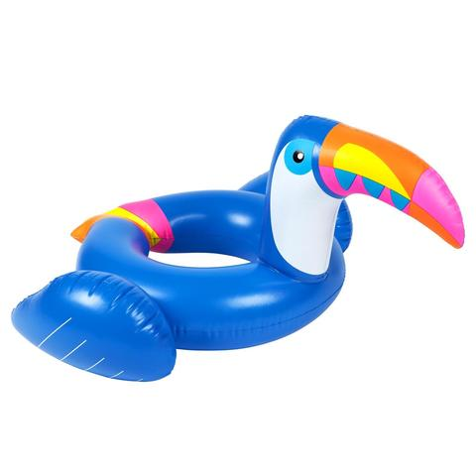
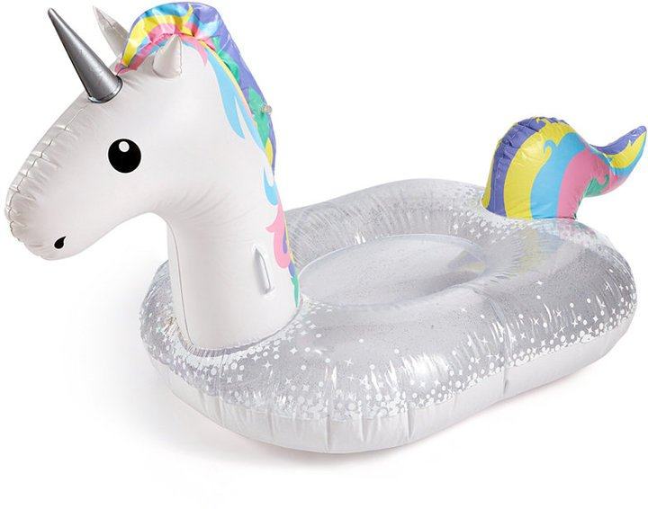
Current Build Infrastructure
Build, Integrate, Test
Hosted Build Agent Pool
Contoso – Build Pool
Northwind – Build Pool

Slide 18
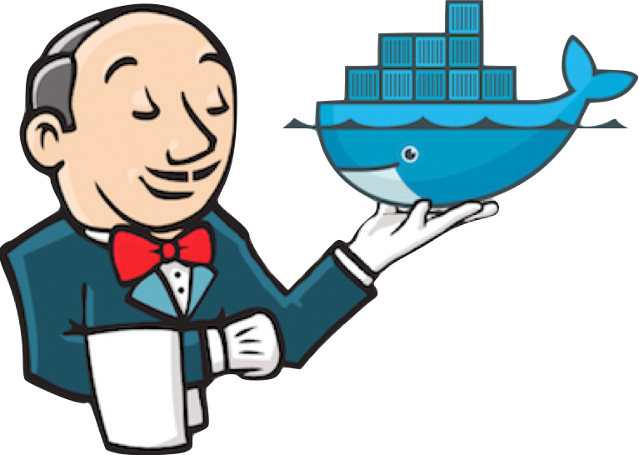
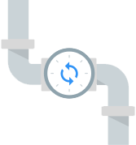


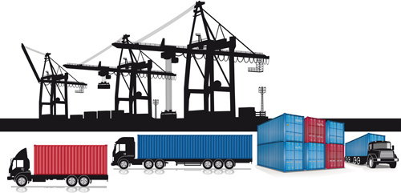
Container Builds - using a Container Mindset
Build, Integrate, Test
Hosted Build Agent Pool

Slide 19
ACR Build A primitive of container lifecycle management
aka.ms/acr/build

Slide 20




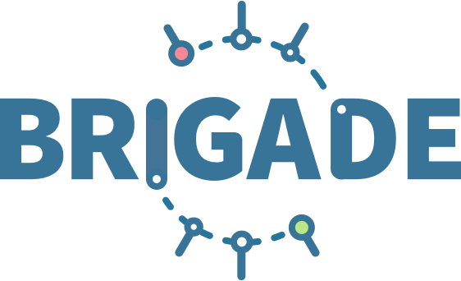
ACR Build: Container OS & Framework Patching
.NET
Registries
Docker Hub
MCR
ACR
Build Triggers
SCC Providers
ACR Build
Azure Container Registry
aka.ms/acr/build

Slide 21
Container Lifecycle Primitives
Host agents monitor, protect and report running containers
3
Container Service
Container Instances
Source Code Control
(SCC)
Build/CI,
Integrate,
Test
CD, Deploy
7
App Services
Upon release, set released flag in ACR (ACR-Auto-purge policies)
Service Fabric
.NET
6
Base Image Index
4
8
1
2
Azure Functions
Docker Hub
ACR Build
Azure Container Registry
IoT
Azure Container Registry
Image Security Scanning
Secure by default
Microsoft Container Registry
Inner-Loop
Azure Batch
Run
5
Code
Validate
Debug
* Work in progress

Slide 22


Dockerfile FROM
Build-task
Functional Tests
Base Images
Commit Id
Id
Context
Dependencies
ACR
d5ab1fa
fx:1
fx:1^{(a)}
fx:1
Web-Build
1
fx:1
web:sha@la
web:1
deploy/test
deploy
web:1
web:1
test:t
Context
d5ab1fa
test:1
Dependencies
web:1
Integration Env
FROM jenga.azurecr.io/baseimages/fx:1
COPY . /output
EXPOSE 80
ENTRYPOINT ["entryPoint"]
If docker build succeeds (including any unit tests),
Save the context & base image dependencies
web:1
az acr build-task create \
–n Web-Build \
–t web:${{.Build.ID}} \
–c github.com/demo42/web \
–-git-access-token $PAT \
–r jenga
Staging Env

Slide 23
Dockerfile FROM
Build-task
Functional Tests
Base Images
Commit Id
Id
Context
Dependencies
ACR
fx:1^{(a)}
fx:1
d5ab1fa
Web-Build
1
fx:1
web:sha@la
web:1
deploy/test
deploy
Context
fx:1^{(b)}
fx:1^{(b)}
2
fx:1^{(b)}
web:sha@ya
web:2
deploy/test
deploy
web:2
web:2
d5ab1fa
test:2
test:2
Dependencies
fx:1^{(a)}
web:2
fx ships an OS &/or FX Patch, using the stable 1 tag
The build-task is monitoring changes based on the last build
Integration Env
Base image updates restore the previous context
If Build & Unit Tests Succeed,
Update the base image dependencies
web:2
Staging Env

Slide 24
Dockerfile FROM
Build-task
Functional Tests
Base Images
Commit Id
Id
Context
Dependencies
ACR
d5ab1fa
Web-Build
fx:1
fx:1^{(a)}
fx:1
Web-Build
1
web:sha@la
web:1
deploy/test
deploy
Context
fx:1^{(b)}
fx:1^{(b)}
2
fx:1^{(b)}
web:sha@ya
web:2
deploy/test
deploy
web:2
web:2
ef26q5c
test:2
d5ab1fa
test:3
fx:2^{(d)}
fx:2^{(d)}
fx:2
ef26q5c
3
fx:2^{(d)}
web:sha@qe
web:3
deploy/test
deploy
web:3
web:3
Dependencies
test:4
Dependencies
fx:1^{(a)}
fx:1^{(b)}
web:3
FROM jenga.azurecr.io/baseimages/fx:2
COPY . /output
EXPOSE 80
ENTRYPOINT ["entryPoint"]
Integration Env
web:2
web:3
If docker build succeeds (including any unit tests),
Save the context & base image dependencies
Staging Env
Container OS & Framework Patching

Slide 25
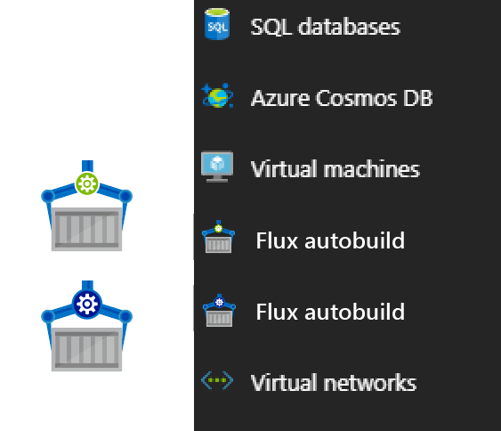


Contoso (Returns)
1 Pull Request
= 1 Build
= 1 Push
= 1 Scan
= 1 Test
= 1 Deploy
$$(1pr=1b+1p+ 1t+1d) ∗life of development$$
Contoso (*)
= 1 Build
= 1 Push
= 1 Scan
= 1 Test
= 1 Deploy
= 1 Build
= 1 Push
= 1 Scan
= 1 Test
= 1 Deploy
= 1 Build
= 1 Push
= 1 Scan
= 1 Test
= 1 Deploy
.NET
Northwind
= 1 Build
= 1 Push
= 1 Scan
= 1 Test
= 1 Deploy
= 1 Build
= 1 Push
= 1 Scan
= 1 Test
= 1 Deploy
= 1 Build
= 1 Push
= 1 Scan
= 1 Test
= 1 Deploy
Smart Hotel 360
= 1 Build
= 1 Push
= 1 Scan
= 1 Test
= 1 Deploy
= 1 Build
= 1 Push
= 1 Scan
= 1 Test
= 1 Deploy
= 1 Build
= 1 Push
= 1 Scan
= 1 Test
= 1 Deploy
Adventure Works
= 1 Build
= 1 Push
= 1 Scan
= 1 Test
= 1 Deploy
= 1 Build
= 1 Push
= 1 Scan
= 1 Test
= 1 Deploy
= 1 Build
= 1 Push
= 1 Scan
= 1 Test
= 1 Deploy
Fabrikam
= 1 Build
= 1 Push
= 1 Scan
= 1 Test
= 1 Deploy
= 1 Build
= 1 Push
= 1 Scan
= 1 Test
= 1 Deploy
= 1 Build
= 1 Push
= 1 Scan
= 1 Test
= 1 Deploy
$$1patch=cust ∗apps ∗ \left(1b+1p+ 1t+1d\right)∗life of the app$$

Slide 26


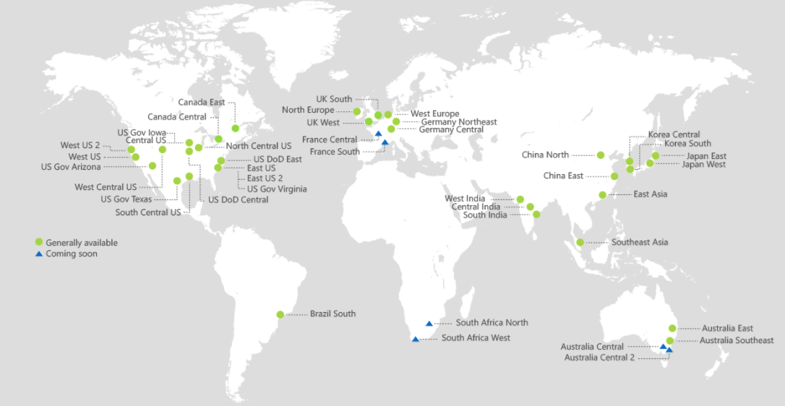
ACR Geo-replication
Mange your global/local deployments as one resource
http://aka.ms/acr/geo-replication

Slide 27
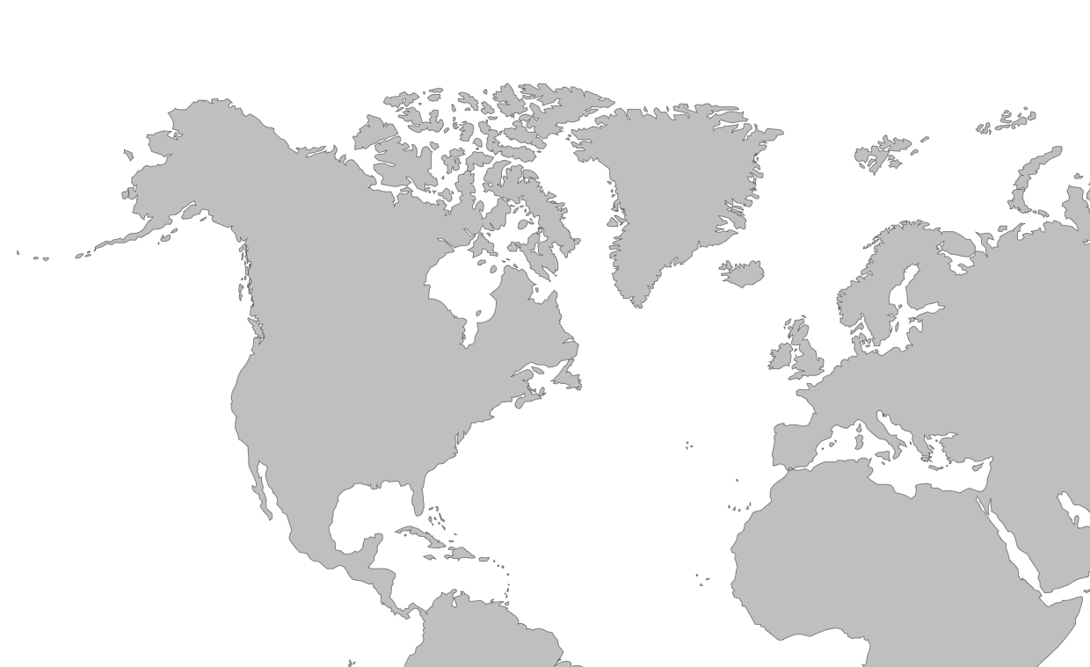

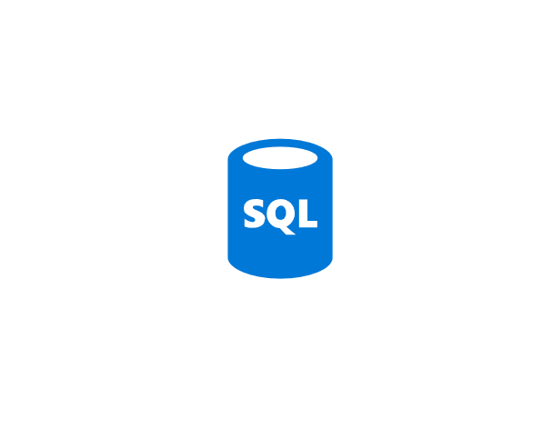

Push Built Images
docker push contosowestus.azurecr.io/web:1234
docker push contosowesteurope.azurecr.io/web:1234
Nodes Pull Images
docker pull contosowestus.azurecr.io/web:1234
docker pull contosowesteurope.azurecr.io/web:1234
Pulls are local, network-close, fast, reliable
Pulls are remote, across the public internet, slower, less reliable
Have network egress fees
Pulls are remote, across the public internet, slower, less reliable
Have network egress fees
West Europe
Canada Central
West US
East US
Developers must push images to n registries, requiring separate management and configuration

Slide 28

Push Built Images
docker push contoso.azurecr.io/web:1234
ACR Syncs Image Blobs
Regional Web Hooks fire for local deployments
Nodes Pull Images
docker pull contoso.azurecr.io/web:1234
Geo-replicate a single registry
All regions have a local replica
Geo-replicate a single registry
All regions have a local replica
West Europe
Canada Central
West US
East US
Each registry is pulling from a local, network close, reliable registry

Slide 29
Azure Container Registry
Providing a single registry across the globe
aka.ms/ACR
aka.ms/ACR/Docs
aka.ms/ACR/Geo-replication
aka.ms/ACR/Roadmap

Slide 30
Containers are the modern Virtualization Stack An evolution, revolution, or circle of service?

Slide 31
– Mainframes
CIRCA 1980

Slide 32
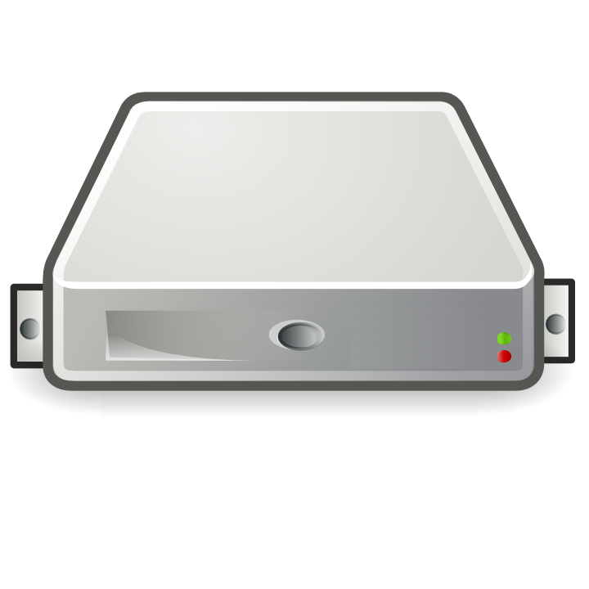
– PC → Server Revolution
CIRCA 1990
$
$
$
$
$
$
$
$
$
$
$
$
$
$
$
$
$
$
$
$
$
$
$
$
$
$
$
$
$
$
$
$
$
$
$
$
$
$
$
$
$
$
$
$
$
$
$
$
$
$
$
$
$
$
$

Slide 33
– Server → VM Evolution
CIRCA 2000
Guest OS #5
Guest OS #6
Guest OS #7
Guest OS #8
Guest OS #5
Guest OS #6
Guest OS #7
Guest OS #8
Guest OS #5
Guest OS #6
Guest OS #7
Guest OS #8
Guest OS #5
Guest OS #6
Guest OS #7
Guest OS #8
Guest OS #5
Guest OS #6
Guest OS #7
Guest OS #8
Guest OS #1
Guest OS #2
Guest OS #3
Guest OS #4
Guest OS #1
Guest OS #2
Guest OS #3
Guest OS #4
Guest OS #1
Guest OS #2
Guest OS #3
Guest OS #4
Guest OS #1
Guest OS #2
Guest OS #3
Guest OS #4
Guest OS #1
Guest OS #2
Guest OS #3
Guest OS #4
Hyper Visor
Hyper Visor
Hyper Visor
Hyper Visor
Hyper Visor
$
$
$
$
$

Slide 34
– VM → Cloud Evolvement
CIRCA 2015
Guest OS #5
Guest OS #6
Guest OS #7
Guest OS #8
Guest OS #5
Guest OS #6
Guest OS #7
Guest OS #8
Guest OS #5
Guest OS #6
Guest OS #7
Guest OS #8
Guest OS #5
Guest OS #6
Guest OS #7
Guest OS #8
Guest OS #5
Guest OS #6
Guest OS #7
Guest OS #8
$
$
$
$
$
$
$
$
$
$
$
$
$
$
$
$
$
$
$
$
Guest OS #1
Guest OS #2
Guest OS #3
Guest OS #4
Guest OS #1
Guest OS #2
Guest OS #3
Guest OS #4
Guest OS #1
Guest OS #2
Guest OS #3
Guest OS #4
Guest OS #1
Guest OS #2
Guest OS #3
Guest OS #4
Guest OS #1
Guest OS #2
Guest OS #3
Guest OS #4
$
$
$
$
$
$
$
$
$
$
$
$
$
$
$
$
$
$
$
$
Hyper Visor
Hyper Visor
Hyper Visor
Hyper Visor
Hyper Visor

Slide 35
– Cloud → Containerization
CIRCA 2015
Guest OS #2
Guest OS #2
Guest OS #2
Guest OS #2
Guest OS #2
$
$
$
$
$
Guest OS #1
Guest OS #2
Guest OS #3
Guest OS #4
Guest OS #1
Guest OS #2
Guest OS #3
Guest OS #4
Guest OS #1
Guest OS #2
Guest OS #3
Guest OS #4
Guest OS #1
Guest OS #2
Guest OS #3
Guest OS #4
Guest OS #1
Guest OS #2
Guest OS #3
Guest OS #4
$
$
$
$
$
Hyper Visor
Hyper Visor
Hyper Visor
Hyper Visor
Hyper Visor

Slide 36

Containers as a 1st Class Primitive
Distributed, Scalable Mainframe
CIRCA 2017
Azure Container Instances

Slide 37
Container Dev/Ops Workflows Similar, yet different…

Slide 38
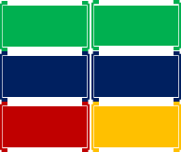
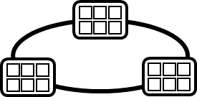
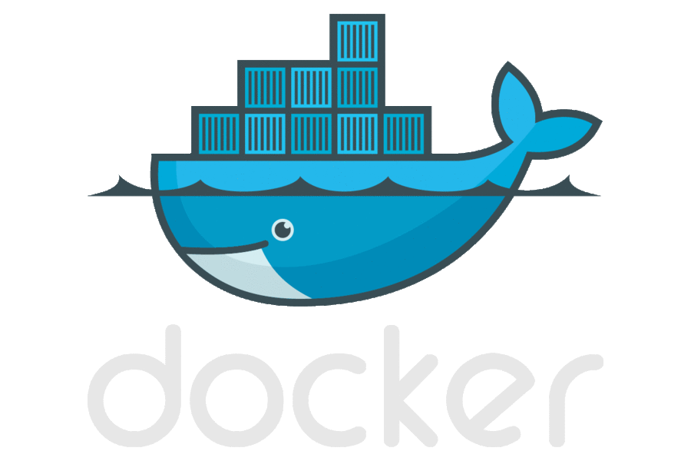

Container DevOps Workflow – w/Production Support
Container Service
OS & Framework Patching
What happens when developers stop making code changes?
Run, Manage
Service Fabric
Source Code Control
(SCC)
Build/CI,
Integrate,
Test
CD, Deploy
App Services
Production
environments
coming soon
Base Image Index
…
Docker Hub
Azure Container _Builder*
Azure Container Registry
…
Inner-Loop
…
Run
Monitor and Diagnose
Code
Validate
Debug

Slide 39
ACR Geo-replication
Mange your global/local deployments as one resource

